Slide 1
Research Process Steps

Slide 2
Research Process Steps
The research process consists of a series of systematic procedures that a researcher must go through in order to generate knowledge that will be considered valuable by the project and focus on the relevant topic.
To conduct effective research, you must understand the research process steps and follow them. Here are a few steps in the research process to make it easier for you:

Slide 3
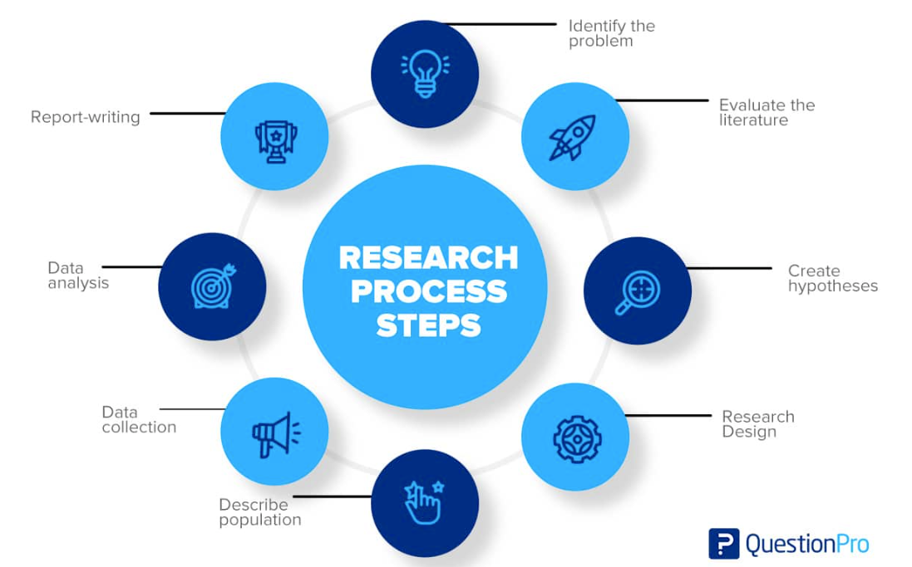

Slide 4
Step 1: Identify the Problem
Finding an issue or formulating a research question is the first step. A well-defined research problem will guide the researcher through all stages of the research process, from setting objectives to choosing a technique. There are a number of approaches to get insight into a topic and gain a better understanding of it. Such as:
A preliminary survey
Case studies
Interviews with a small group of people
Observational survey

Slide 5
Step 2: Evaluate the Literature
A thorough examination of the relevant studies is essential to the research process. It enables the researcher to identify the precise aspects of the problem. Once a problem has been found, the investigator or researcher needs to find out more about it.
This stage gives problem-zone background. It teaches the investigator about previous research, how they were conducted, and its conclusions. The researcher can build consistency between his work and others through a literature review. Such a review exposes the researcher to a more significant body of knowledge and helps him follow the research process efficiently.

Slide 6
Step 3: Create Hypothesis
Formulating an original hypothesis is the next logical step after narrowing down the research topic and defining it. A belief solves logical relationships between variables. In order to establish a hypothesis, a researcher must have a certain amount of expertise in the field.
It is important for researchers to keep in mind while formulating a hypothesis that it must be based on the research topic. Researchers are able to concentrate their efforts and stay committed to their objectives when they develop theories to guide their work.

Slide 7
Step 4: The Research Design
Research design is the plan for achieving objectives and answering research questions. It outlines how to get the relevant information. Its goal is to design research to test hypotheses, address the research questions, and provide decision-making insights.
The research design aims to minimize the time, money, and effort required to acquire meaningful evidence. This plan fits into four categories:
Exploration and Surveys
Experiment
Data Analysis
Observation

Slide 8
Step 5: Describe Population
Research projects usually look at a specific group of people, facilities, or how technology is used in the business. In research, the term population refers to this study group. The research topic and purpose help determine the study group.
Suppose a researcher wishes to investigate a certain group of people in the community. In that case, the research could target a specific age group, males or females, a geographic location, or an ethnic group. A final step in a study’s design is to specify its sample or population so that the results may be generalized.

Slide 9
Step 6: Data Collection
Data collection is important in obtaining the knowledge or information required to answer the research issue. Every research collected data, either from the literature or the people being studied. Data must be collected from the two categories of researchers. These sources may provide primary data.
Experiment
Questionnaire
Observation
Interview
Secondary data categories are:
Literature survey
Official, unofficial reports
An approach based on library resources

Slide 10
Step 7: Data Analysis
During research design, the researcher plans data analysis. After collecting data, the researcher analyzes it. The data is examined based on the approach in this step. The research findings are reviewed and reported.
Data analysis involves a number of closely related stages, such as setting up categories, applying these categories to raw data through coding and tabulation, and then drawing statistical conclusions. The researcher can examine the acquired data using a variety of statistical methods.

Slide 11
Step 8: The Report-writing
After completing these steps, the researcher must prepare a report detailing his findings. The report must be carefully composed with the following in mind:
The Layout: On the first page, the title, date, acknowledgments, and preface should be on the report. A table of contents should be followed by a list of tables, graphs, and charts if any.
Introduction: It should state the research’s purpose and methods. This section should include the study’s scope and limits.
Summary of Findings: A non-technical summary of findings and recommendations will follow the introduction. The findings should be summarized if they’re lengthy.
Principal Report: The main body of the report should make sense and be broken up into sections that are easy to understand.
Conclusion: The researcher should restate his findings at the end of the main text. It’s the final result.

